Slide 1
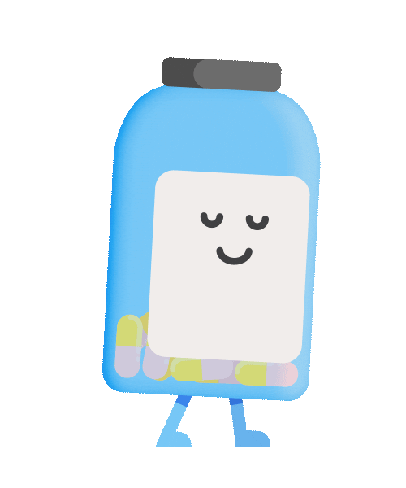
Medminder
Presented by: Ahmed Farag

Slide 2
Agenda
Introduction
Motivation
Related Work
Problem Definition
Main Objectives
System Architecture
User Interaction Design
System Requirements (S/W and H/W Tools)
Results and Outcomes
Conclusion and Future Work

Slide 3
Introduction
We designed a medicine reminder application that fulfills everyone’s medication needs in one place: pill reminders, support for any dosage form (incl. tablet, pill, inhalation, injection), frequency, and even refill reminders.
Our application isn’t made for patients and sick people only, nurses could also use our application to keep track of the patients they are taking care of.
Our main goal is to keep the application as accessible and straightforward as possible.

Slide 4
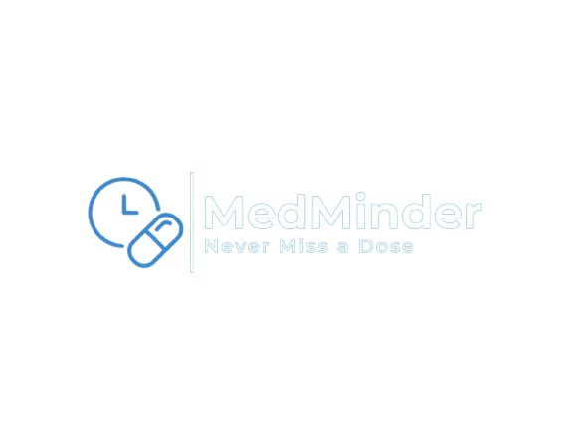
Motivation
Why use our application ?
Friendly Interface
No need to internet connection (only for chatbot)
Costless

Slide 5
Related Work
MedsLog
Medhelper
Dosecast
Mango Health
Pros | Cons | Feature
Medicine Reminder | Bad Interface Costly | No Unique Feature
Friendly Interface Take Notes | Needs Internet connection | Database stores information about each medicine
Friendly Interface Customize Ringtone | Costly Needs internet connection | Multiple Devices
Friendly Interface | Needs Internet connection | Healthy Activity

Slide 6
Related Work
Pros | Cons | Feature
Friendly Interface | Needs Internet Connection | Virtual Assistant
Friendly Interface Customize Ringtone | Needs Internet Connection | Link With Specific Doctor
Friendly Interface | Needs Internet Connection | Group Sharing
EveryDose
MyTherapy Pill Reminder
Medisafe Pill & Med Reminder

Slide 7
Problem Definition
What problems people face without the application?
Medication Adherence Complex Medication Schedule
Refill Medicine
Features of project that solve the problem?
Reminder Add Medicine Text Recognition Export PDF Ai chatbot

Slide 8
Main Objectives
Our objective is to design an application that will:
Remind patients to take their medications on time.
Remind patients to refill their medications before they run out.
Remind patients the dose for each medicine.
Provide means to carry around a handwritten medication memo at all times.
Store medicine and its information in a database, if a user uses the same medicine more than one time.

Slide 9
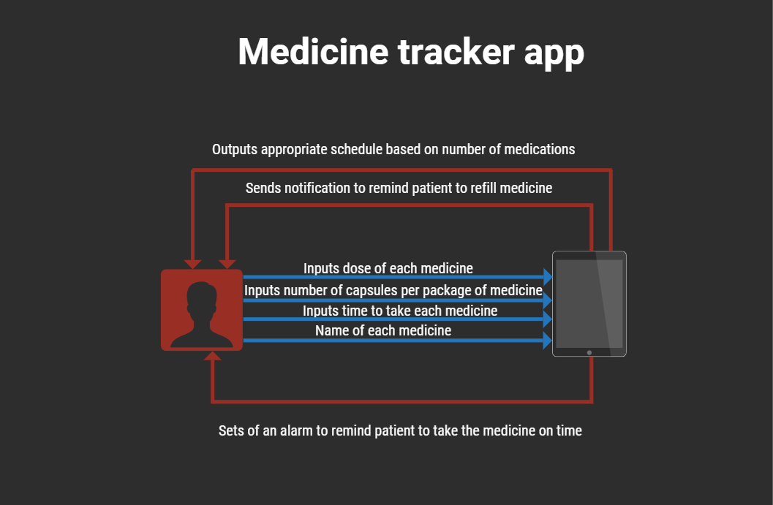
System Architecture

Slide 10
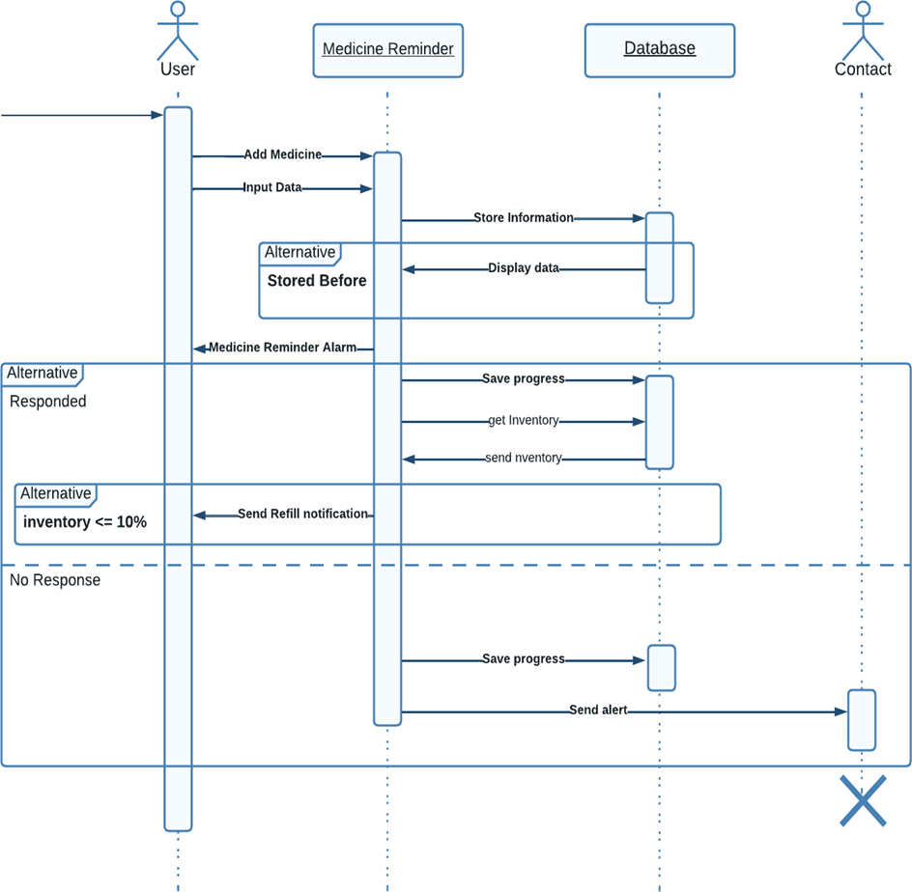
User Interaction Design

Slide 11
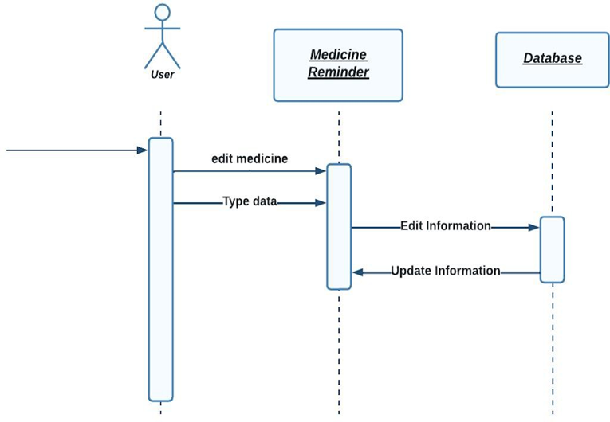
User Interaction Design

Slide 12
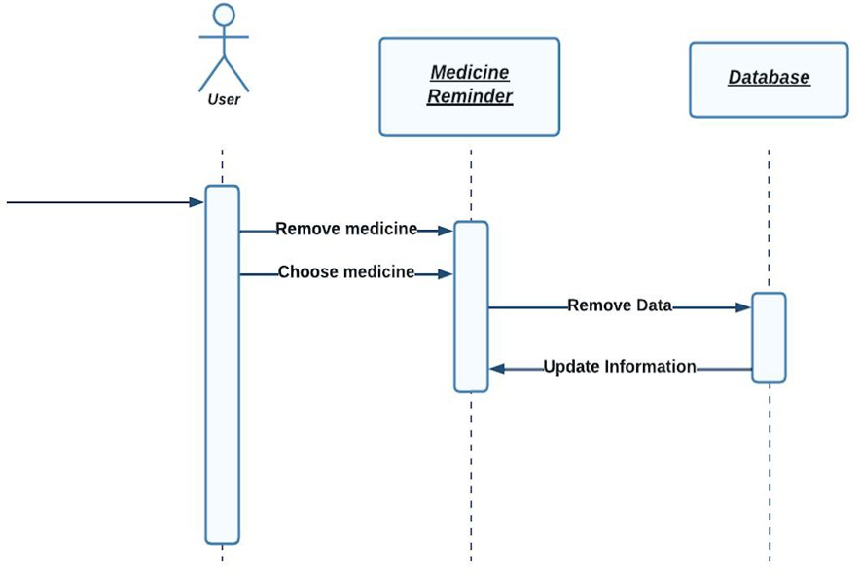
User Interaction Design

Slide 13





System Requirements (S/W and H/W Tools)
Software
Hardware
Processor: intel core i7 11th generation
Ram: 16 Giga Byte (GB)
Offline emulator
Any android device that can run android application is a suitable hardware for the Medicine Tracker project
Android
Visual studio

Slide 14
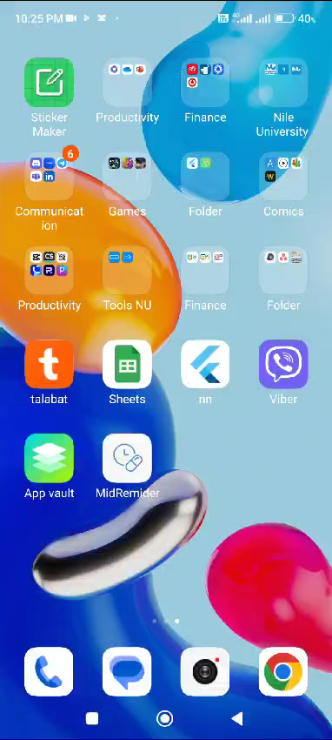
Results and Outcomes

Slide 15

Conclusion
Our medical app project aims to enhance medication adherence and health outcomes by providing personalized reminders, managing schedules, tracking usage, and offering a user-friendly interface, ultimately improving care quality and promoting better health outcomes.

Slide 16
